Slide 1

SafeGuardian AI: Agentic Women Safety and Intelligent SOS Response Platform
SOA Project Review-2
Thursday, September 23rd, 2026
 | Under the Guidance of Dr. Srikanth Cherukuvada Assistant Professor, Department of Computer Science and Engineering, KLH CSE Bowrampet Campus
Team Members B Akhil Varma - 2420030141 K. Vamsidhar - 2420030341 K.V.S. Jaswanth - 2420030467

Slide 2
Outline of Research Work
Focus
Introduction
Literature Survey
Challenges
Research Objectives
Conclusion & Future Work
References
Publications Details

Slide 3
Problem Statement
Women’s safety remains a major concern in today’s world, particularly during situations involving harassment, stalking, unsafe surroundings, or emergencies. Existing safety applications mainly depend on manual SOS activation, basic location sharing, and predefined emergency contacts, which may not be sufficient when a user is unable to interact with the phone or when the surrounding risk needs to be assessed. There is a need for an intelligent safety platform that can combine rapid SOS activation, real-time location monitoring, AI-based threat detection, risk assessment, and coordinated emergency response to provide faster and more context-aware assistance.

Slide 4
Objectives
To make this application:
1. To make this application enable quick SOS activation through a simple interface or voice-based trigger with real-time location sharing.
2. To make this application use an AI Assistant to analyse available contextual information, identify potential threats, and assess the risk level.
3. To make this application provide intelligent emergency response by using SOA-integrated services to route alerts and incident information to appropriate trusted contacts and responders.

Slide 5
Literature Survey
Authors | Title of the Paper | Methodology | Inferences | Limitation/Future work
Harikiran et al. (2016) | Smart Security Solution for Women Based on Internet of Things (IoT) | IoT-based safety device, automatic sensing, communication with nearby people/police | Demonstrates how IoT can support automatic emergency detection and rapid assistance. | Primarily focuses on IoT/device-based safety rather than AI-driven contextual decision-making and coordinated software agents.
Eisenhut et al. (2020) | Mobile Applications Addressing Violence Against Women: A Systematic Review | Systematic review of 327 relevant applications; 171 included and categorized into emergency, avoidance, education, reporting/evidence, and support | Found that 46.78% of reviewed apps primarily provided emergency functions, showing that current solutions are heavily oriented toward one-time emergency response. | Highlights the need for further research into prevention, safety, efficacy, sustainability, and data security.
Akram et al. (2020) | Design of a Smart Safety Device for Women using IoT | IoT safety device with fingerprint verification, automatic alerting, location support, messaging and mobile application | Demonstrates integration of IoT sensing, automatic alerts, location information and communication for women's safety. | Hardware-oriented approach; does not provide a unified agentic AI architecture for threat assessment and intelligent response.
Doria et al. (2021) | Women’s Experiences of Safety Apps for Sexualized Violence: A Narrative Scoping Review | Systematic search and review of studies concerning women's experiences with safety applications | Identified important themes including security, accessibility and knowledge, showing that usability and user experience are important alongside technical features. | Further research is required to address identified gaps and improve the effectiveness and usability of safety applications.
Naaz et al. (2026) | Comprehensive Review on Women Safety Technologies: Indian Perspective | Structured review of women's safety technologies including mobile applications, GPS, IoT, wearables, surveillance and ML | Identifies existing technologies and emphasizes the importance of contextual relevance, accessibility, affordability and improved integration. | Identifies gaps in comprehensive evaluation, Indian-context research, awareness and real-world adoption.

Slide 6
Research Gap Identification
Existing women-safety solutions provide useful capabilities such as SOS alerts, GPS tracking, IoT sensing, audio/video-based detection and emergency communication; however, these capabilities are often implemented as individual solutions rather than being coordinated through a common intelligent system. Most existing applications focus on manual emergency activation or specific safety functions, with limited integration of contextual analysis, intelligent decision-making and coordinated service interaction. Therefore, the identified research gap is the lack of a unified platform where an AI Assistant can interact with and coordinate independent safety services through a Service-Oriented Architecture (SOA) to support intelligent risk assessment and emergency response.

Slide 7
Innovation, Creativity, and Novelty
Proposed Innovation
SafeGuardian AI provides a simple and intelligent emergency-response system that reduces manual actions during an emergency.
Key Innovative Aspects
1. Context-Based AI
Analyzes the situation and identifies the risk level.
2. One-Click SOS
One SOS action starts the location, AI assessment, and emergency response.
3. Multimodal Evidence Sharing
Shares current location, captured camera evidence, and voice evidence during an SOS.
4. Trusted Contact Notification
Automatically processes alerts for the user's saved emergency contacts.
5. Integrated Services
Connects frontend, Spring Boot, PostgreSQL, AI services, and notification services into one system.

Slide 8
Feasibility and Project Plan
Technical Feasibility
1. AI Assistant can coordinate different safety services.
2. SOA enables independent services to communicate through APIs.
3. Spring Boot, FastAPI, REST APIs, PostgreSQL and Docker support development and integration.
Operational Feasibility
1. Users can trigger SOS through the application or voice.
2. AI Assistant can coordinate safety services based on the incident.
3. The system provides risk information, location and emergency alerts.

Slide 9
Feasibility and Project Plan
1. Requirements & Research
Weeks 1–2
Problem analysis, requirements and literature survey
2. Architecture & Design
Weeks 2–3
AI Assistant, SOA architecture, database and API design
3. Core Development
Weeks 3–5
AI Assistant, SOS, Location and core services
4. AI & Intelligent Response
Weeks 5–7
AI detection, risk assessment, notification and alert routing
5. SOA Integration & UI
Weeks 7–10
Service integration, dashboard and user interface
6. Testing & Deployment
Weeks 10–12
Testing, debugging, Docker deployment and final demonstration
Time Feasibility

Slide 10
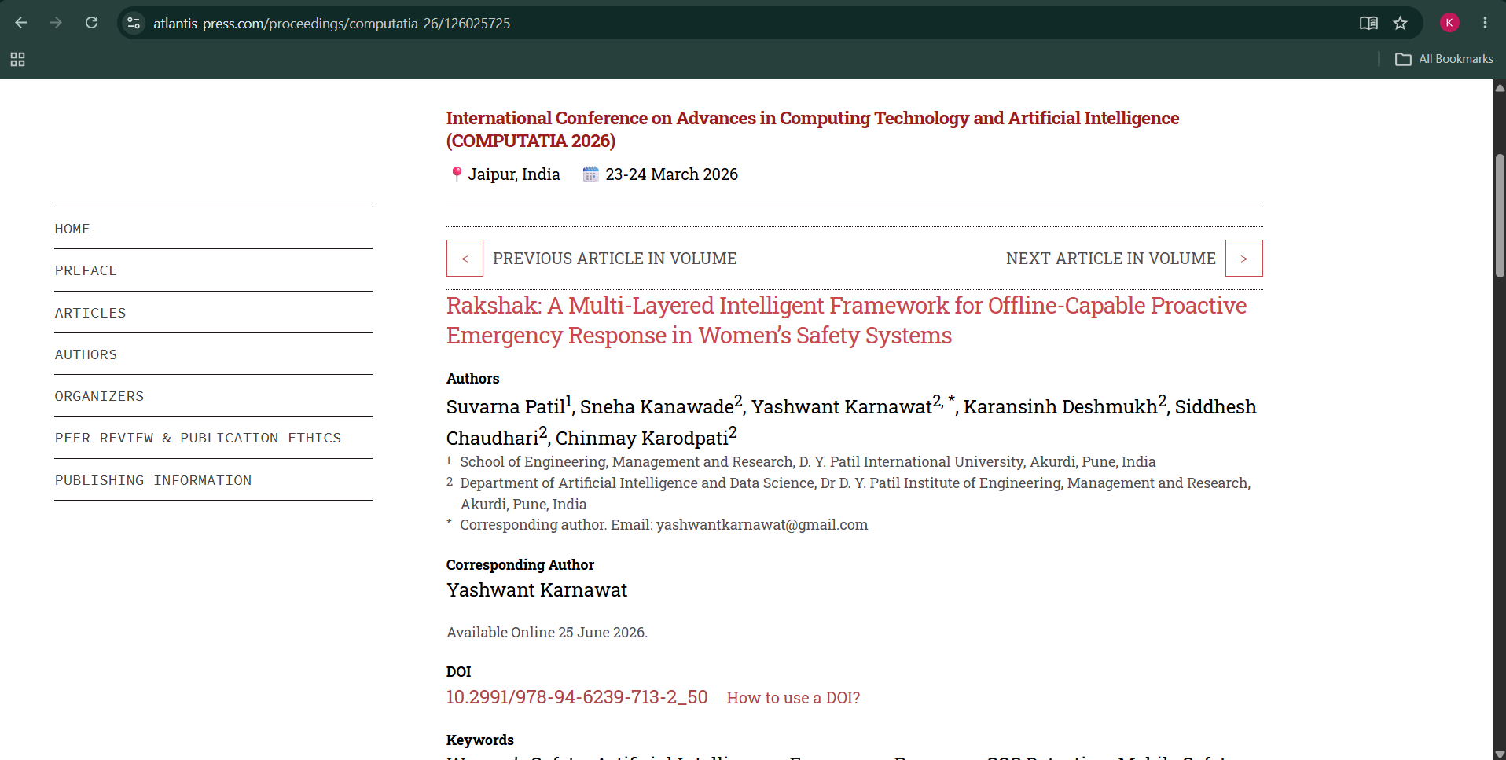
Base Paper

Slide 11
Base Paper Methodology - Rakshak
Danger Situation
Trigger Detection
Danger Detection
SOS
Location
Alert
Contacts
Rakshak uses different ways to detect an emergency, such as voice, eye-blink and tap inputs. When a danger is detected, the system activates SOS, gets the user's location and sends an alert to registered emergency contacts. It also supports emergency communication when internet connectivity is limited.

Slide 12
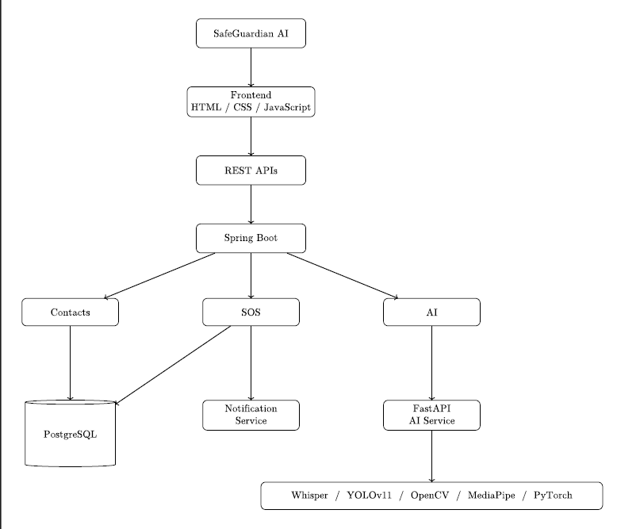
Project Design

Slide 13
Methodology Adopted from Rakshak
One-Click SOS
Get Current Location
AI Threat Assessment
Get Saved Trusted Contacts
Send Emergency Notification
Trusted Contacts
We adopted the proactive emergency-response concept from the base paper. In our system, the user presses SOS once. The system gets the current location, performs AI-based threat assessment, retrieves the saved emergency contacts, and starts the emergency notification process.

Slide 14
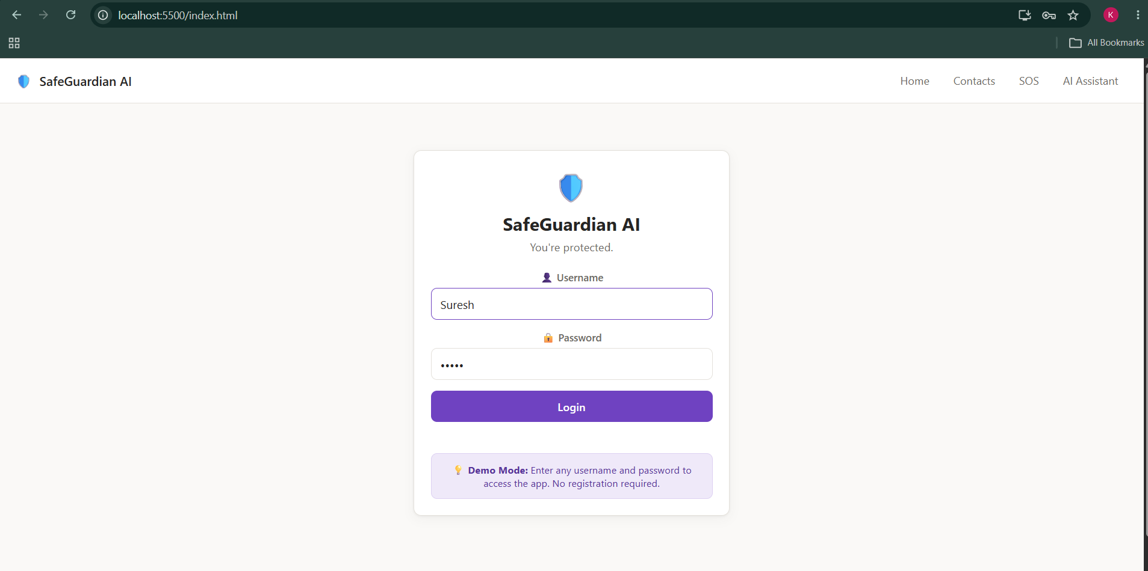
Results

Slide 15
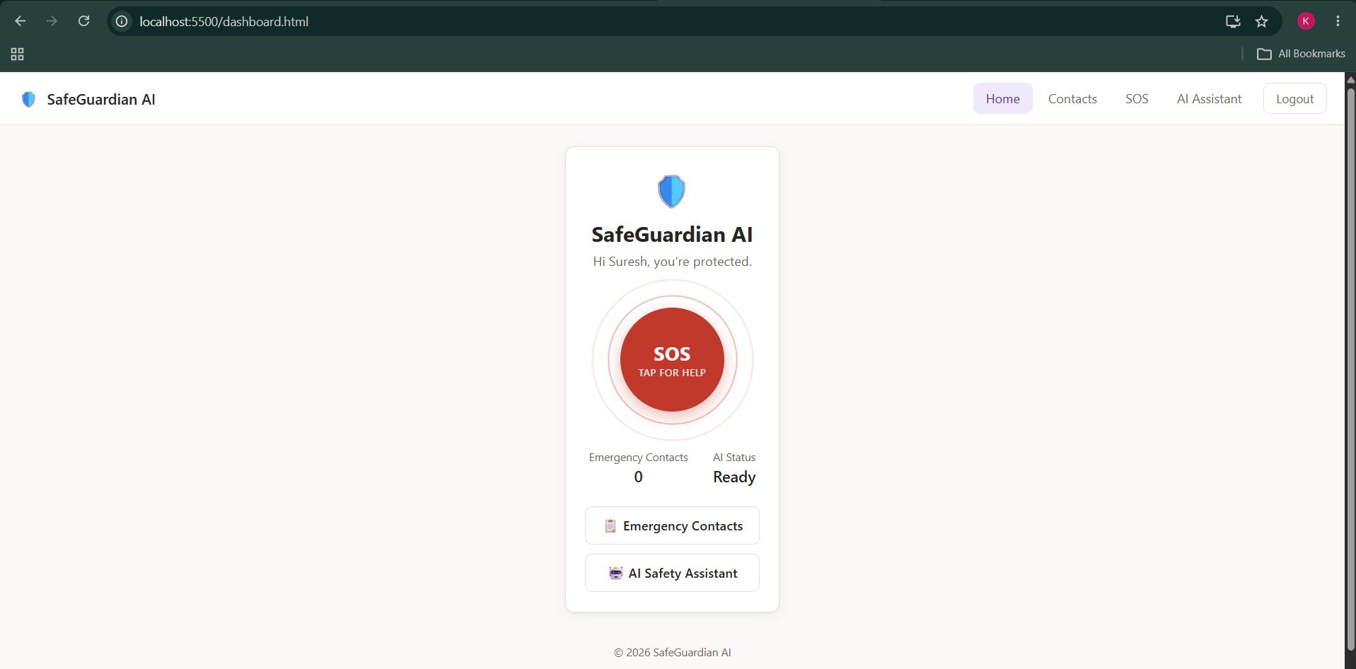
Results

Slide 16
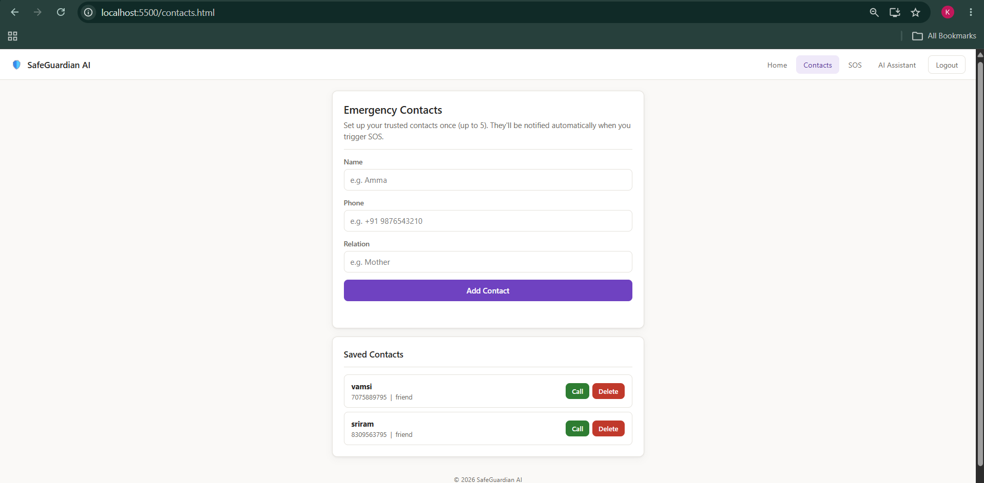
Results

Slide 17
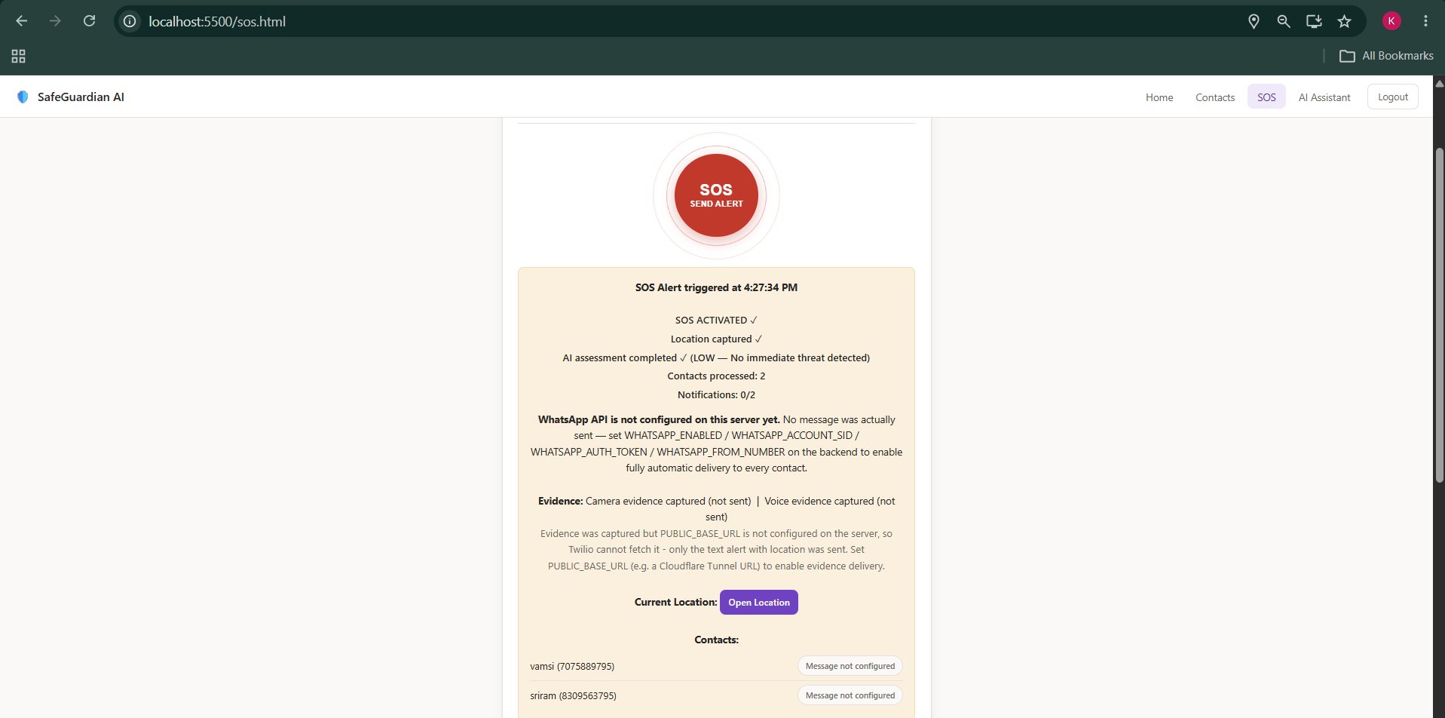
Results

Slide 18
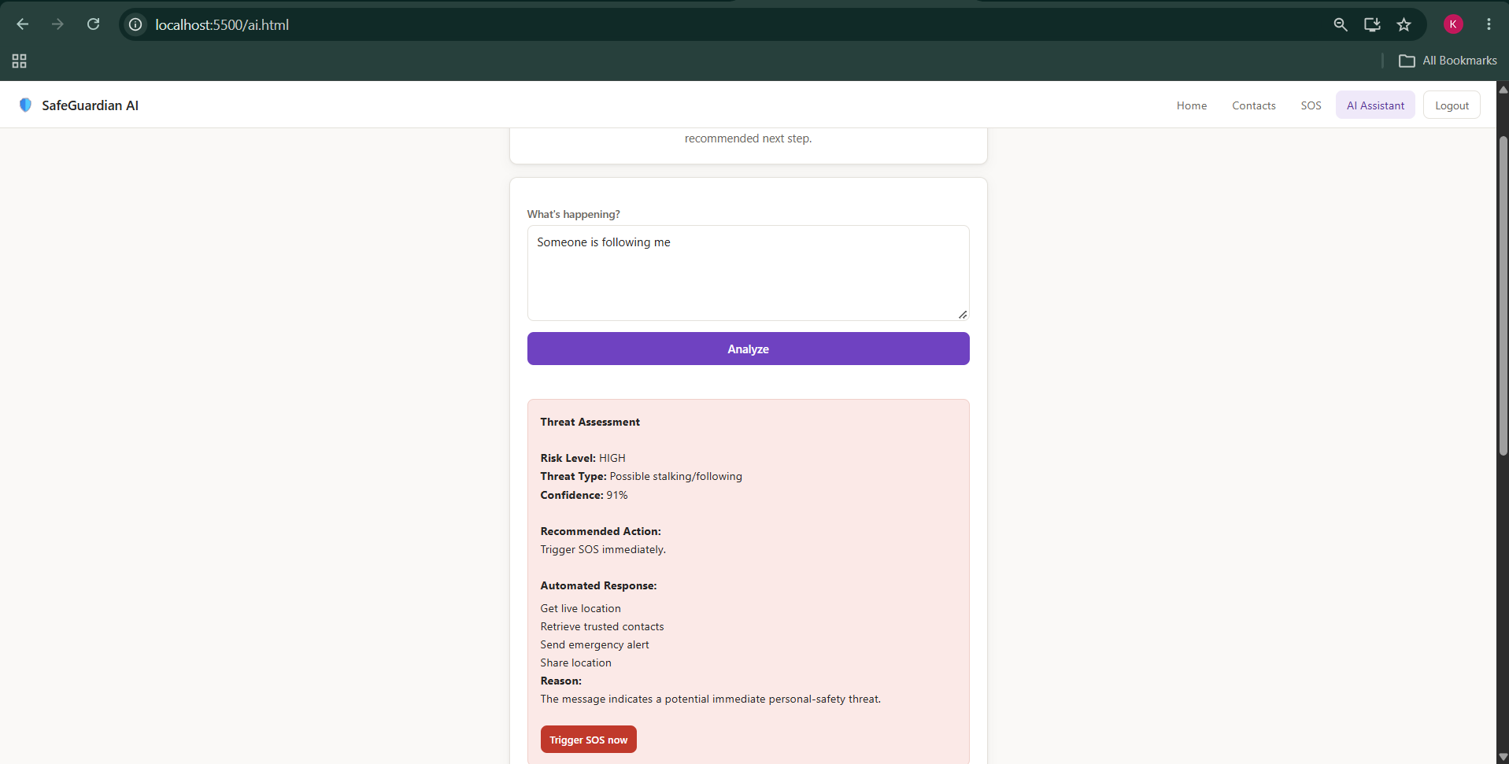
Results

Slide 19
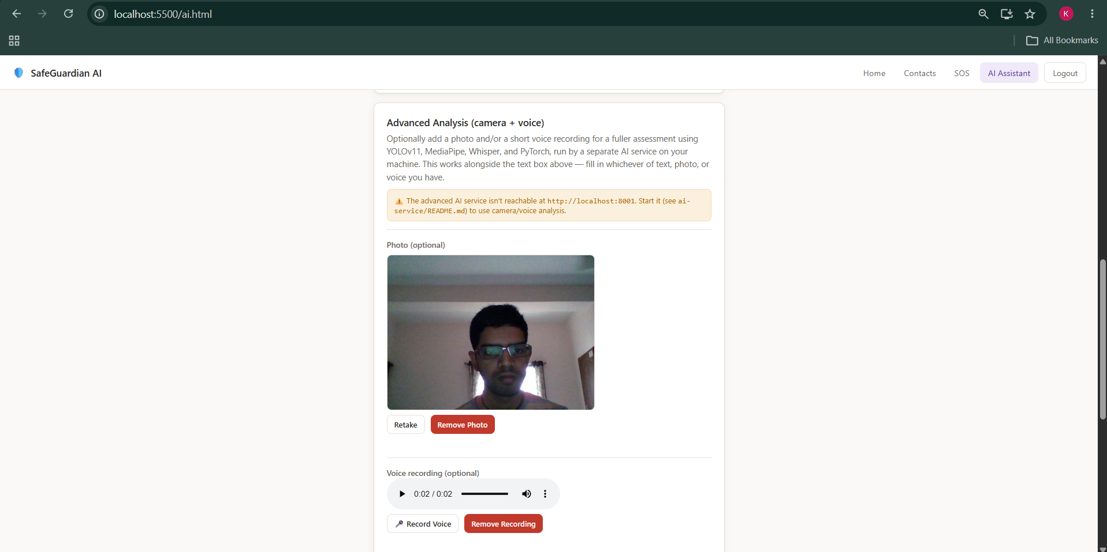
Results

Slide 20
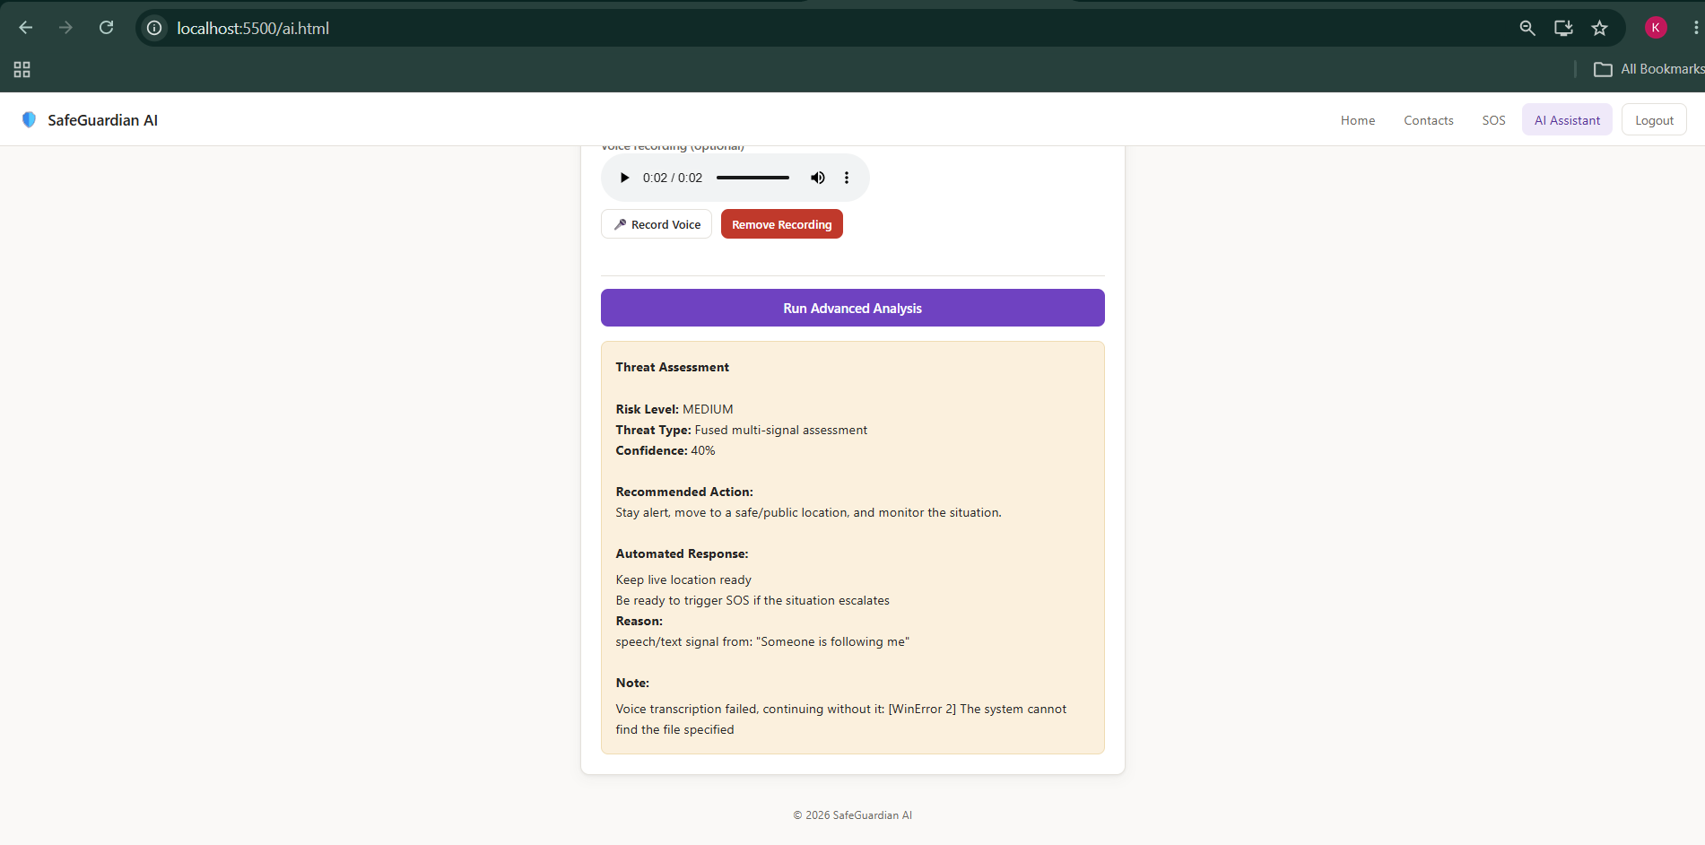
Results

